Slide 1
Getting Started with SageMaker Studio
RMS CDAO AIML & DS Team

Slide 2
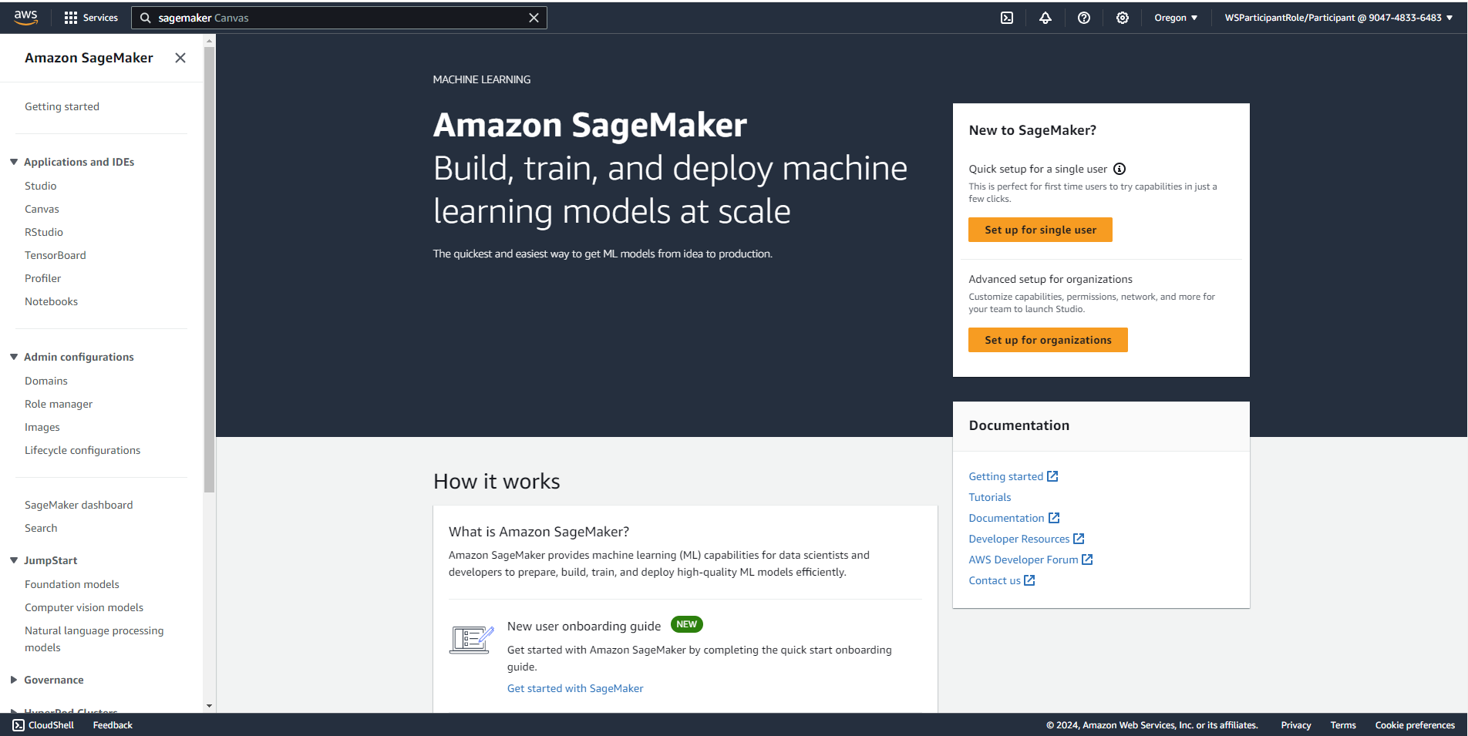
CLICK HERE

Slide 3
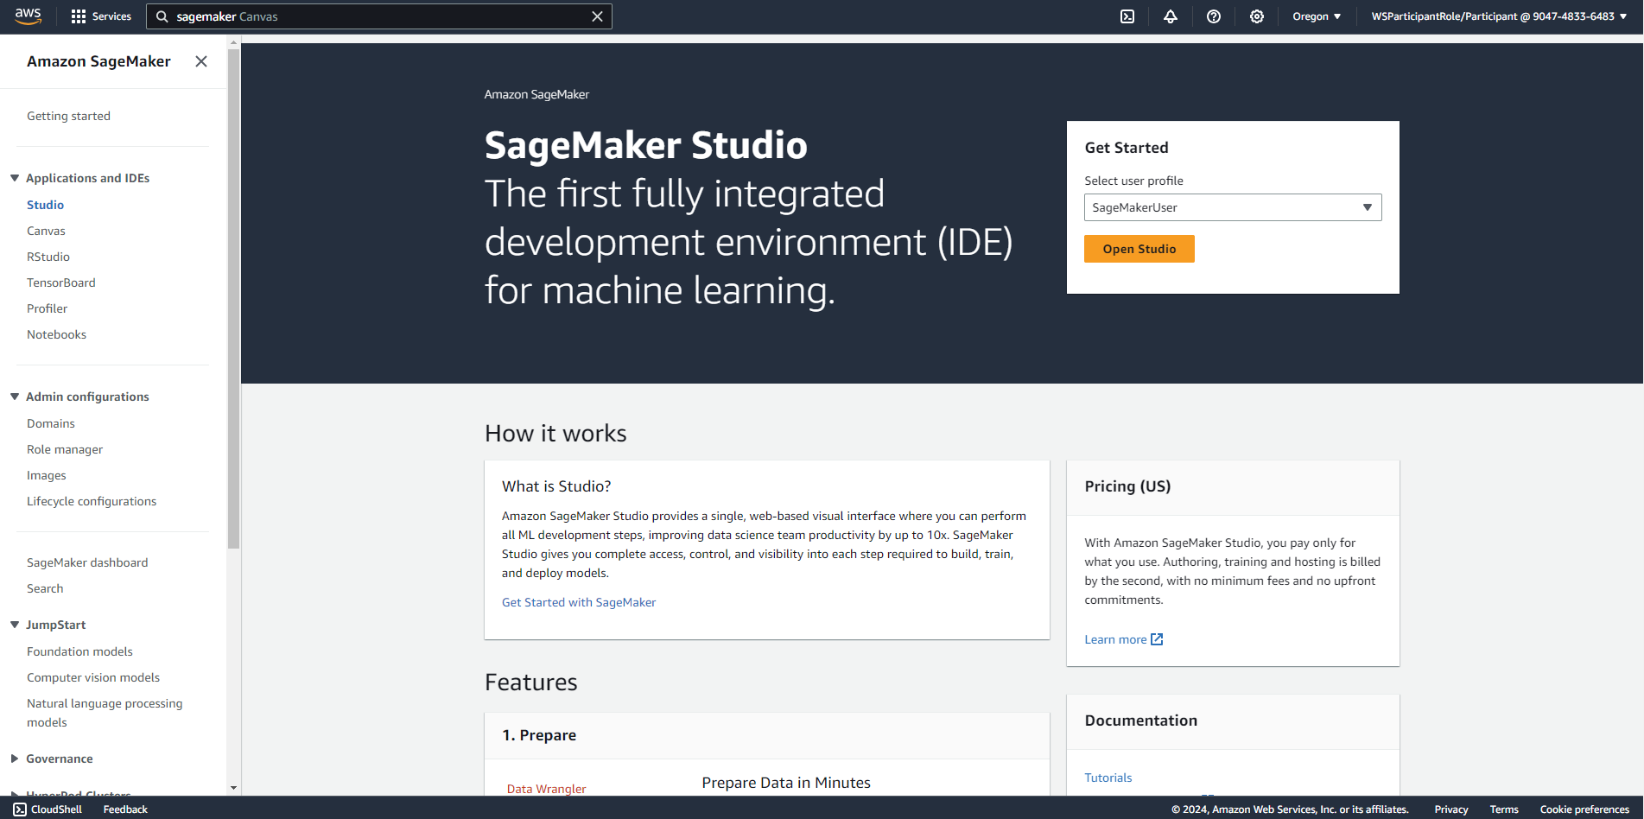
CLICK HERE

Slide 4
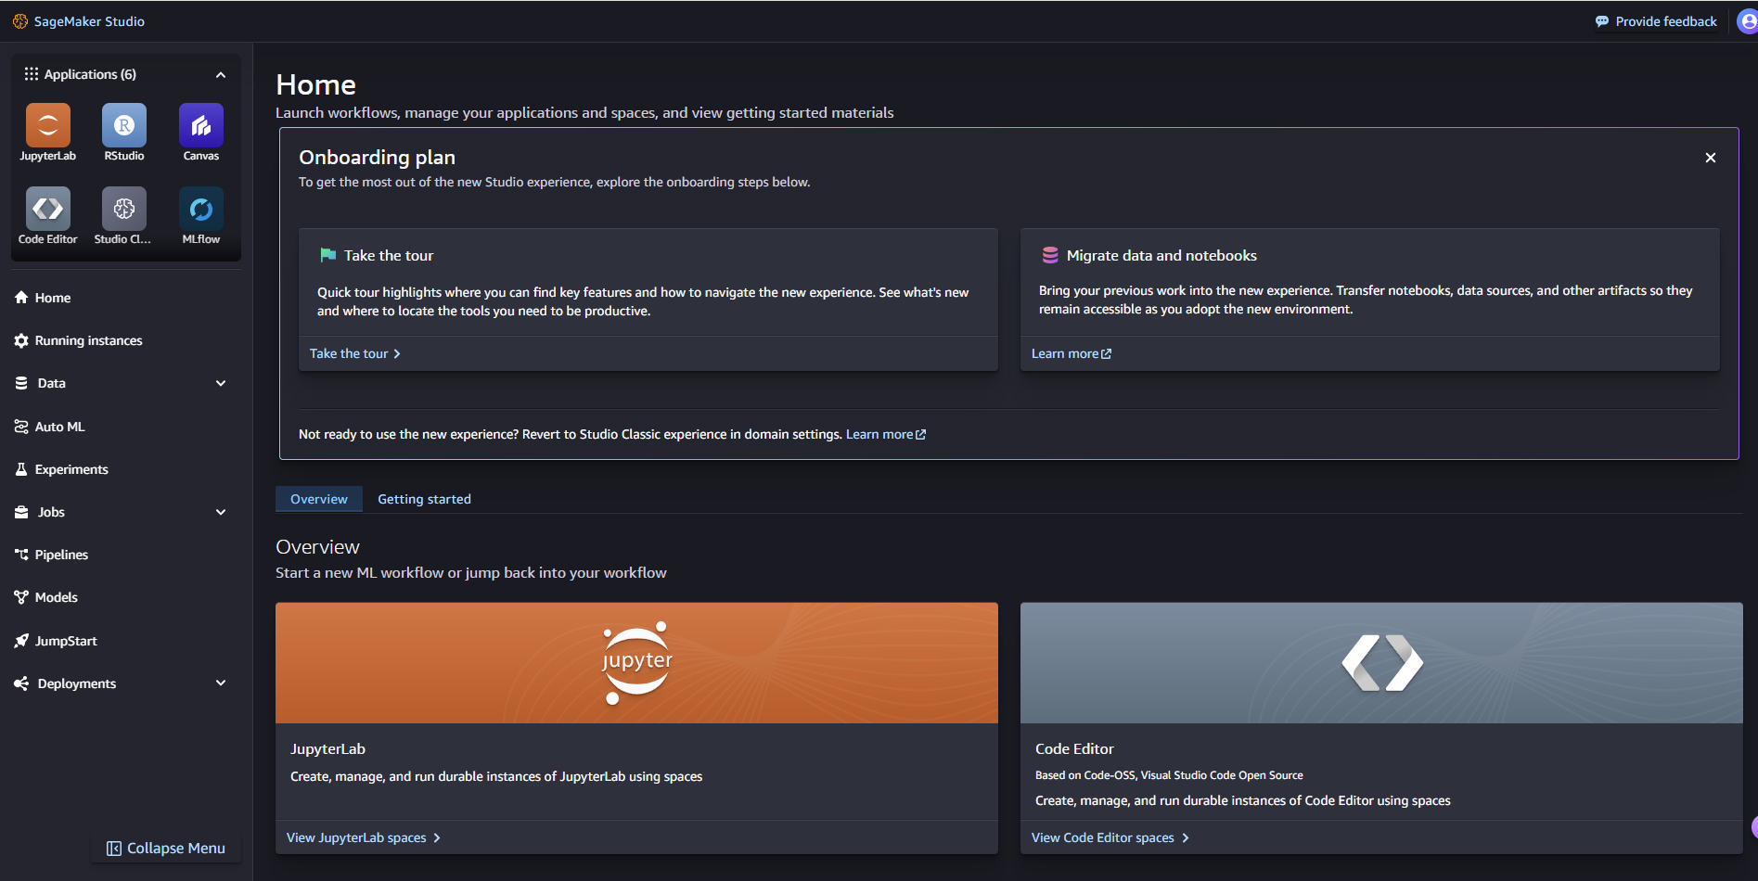
CLICK HERE

Slide 5
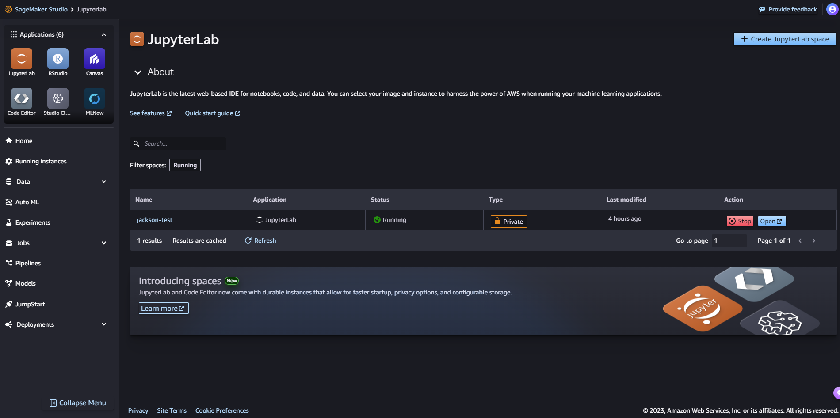
CLICK HERE

Slide 6
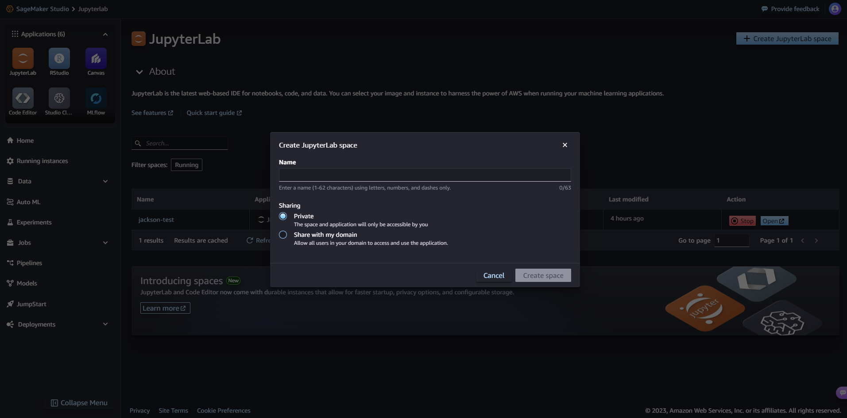
GIVE IT A NAME. DASHES ONLY

Slide 7
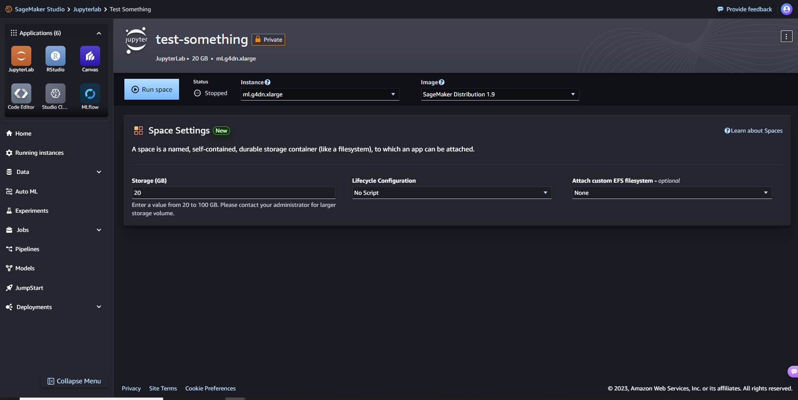
USE ml.g4dn.xlarge
USE 20 GB

Slide 8
CLICK HERE

Slide 9
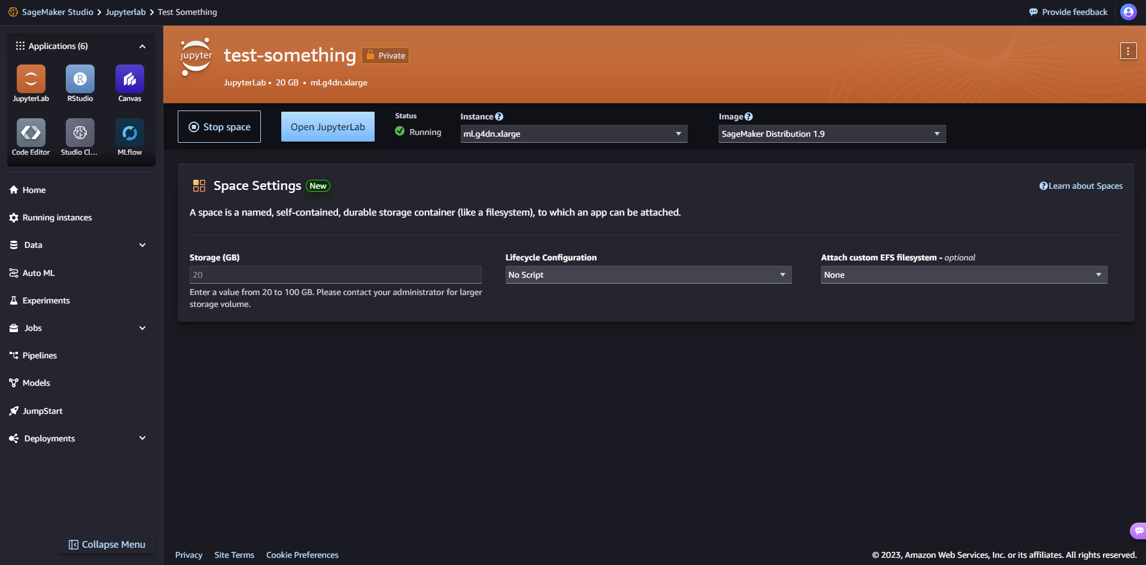
CLICK HERE

